Slide 1
Introduktion til Programmering og Problemløsning (PoP)
List Module
Jon Sporring
Department of Computer Science
2022/09/21

Slide 2
Modulet List
Modulet List indeholder en lang række operationer på lister.
// List creation List.init: m:int -> f:(int -> 'T) -> 'T list
// Argumentet er index let lst = List.init 10 (fun i -> i) val it: int list = [0; 1; 2; 3; 4; 5; 6; 7; 8; 9]
// Ikke triviel funktion let odd i = (i%2 = 1) let lst = List.init 10 odd val lst: bool list = [false; true; false; true; false; true; false; true; false; true]
// Anonyme funktioner let lst = List.init 10 (fun i -> (i%2 = 1)) val lst: bool list =
[false; true; false; true; false; true; false; true; false; true]

Slide 3
Modulet List: init, hvad sker der
// List creation List.init: m:int -> f:(int -> 'T) -> 'T list
// A similar function let rec init (i: int) (m: int) (f: int -> 'T): 'T list = if i >= m then [] else (f i)::(init (i+1) m f) let lst = init 0 4 (fun i -> i*i)
val init: i: int -> m: int -> f: (int -> 'T) -> 'T list val lst: int list = [0; 1; 4; 9]

Slide 4
Modulet List: Map
// list transformation List.map: f:('T -> 'U) -> lst:'T list -> 'U list
// [1...10] -> [log 1.0; log 2.0; ...; log 10.0] let lst = List.map (fun i -> log (float i)) [1..10] val lst: float list = [0.0; 0.6931471806; 1.098612289; 1.386294361; 1.609437912; 1.791759469; 1.945910149; 2.079441542; 2.197224577; 2.302585093]
// ['a'..'z’] -> [ascii 'a’.. ascii 'z'] let lst = List.map (fun i -> int i) ['a'..'z'] val lst: int list = [97; 98; 99; 100; 101; 102; 103; 104; 105; 106; 107; 108; 109; 110; 111; 112; 113; 114; 115; 116; 117; 118; 119; 120; 121; 122]
// (fun i -> f i) = f let lst = List.map int ['a'..'z'] val lst: int list = [97; 98; 99; 100; 101; 102; 103; 104; 105; 106; 107; 108; 109; 110; 111; 112; 113; 114; 115; 116; 117; 118; 119; 120; 121; 122]

Slide 5
Modulet List: map, hvad sker der
// list transformation List.map: f:('T -> 'U) -> lst:'T list -> 'U list
// A similar function let rec map (f: 'T -> 'U) (lst: 'T list) : 'U list = match lst with [] -> [] | elm::rst -> f elm :: map f rst let lst = map (fun i -> i*i) [0..3]
val map: f: ('T -> 'U) -> lst: 'T list -> 'U list val lst: int list = [0; 1; 4; 9]

Slide 6
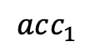
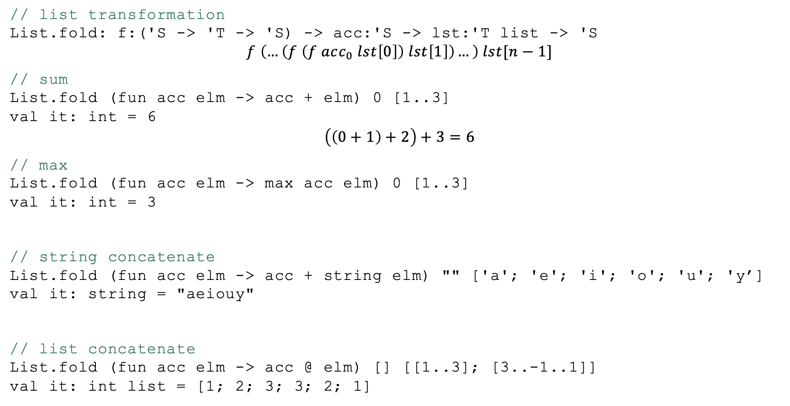
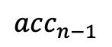
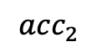
Modulet List: Fold
// list transformation List.fold: f:('S -> 'T -> 'S) -> acc:'S -> lst:'T list -> 'S
$$f \left(…\left(f \left(f acc_{0} lst\left[0\right]\right) lst\left[1\right]\right)…\right) lst[n−1]$$
// sum List.fold (fun acc elm -> acc + elm) 0 [1..3] val it: int = 6
$$\left(\left(0+1\right)+2\right)+3=6$$
// max List.fold (fun acc elm -> max acc elm) 0 [1..3] val it: int = 3
// string concatenate List.fold (fun acc elm -> acc + string elm) "" ['a'; 'e'; 'i'; 'o'; 'u'; 'y’] val it: string = "aeiouy"
// list concatenate List.fold (fun acc elm -> acc @ elm) [] [[1..3]; [3..-1..1]] val it: int list = [1; 2; 3; 3; 2; 1]
$$acc_{1}$$
$$acc_{2}$$
$$acc_{n−1}$$

Slide 7
Modulet List: fold, hvad sker der
// list transformation List.fold: f:('S -> 'T -> 'S) -> acc:'S -> lst:'T list -> 'S
// A similar function let rec fold (f: 'S -> 'T -> 'S) (acc:'S) (lst:'T list) : 'S = match lst with [] -> acc | elm::rst -> fold f (f acc elm) rst let lst = fold (fun acc i -> (i*i)::acc) [] [3..-1..0]
val fold: f: ('S -> 'T -> 'S) -> acc: 'S -> lst: 'T list -> ‘S val lst: int list = [0; 1; 4; 9]

Slide 8
Resumé
I denne video har du hørt om:
Modulet List og List.map og List.fold

